Slide 1
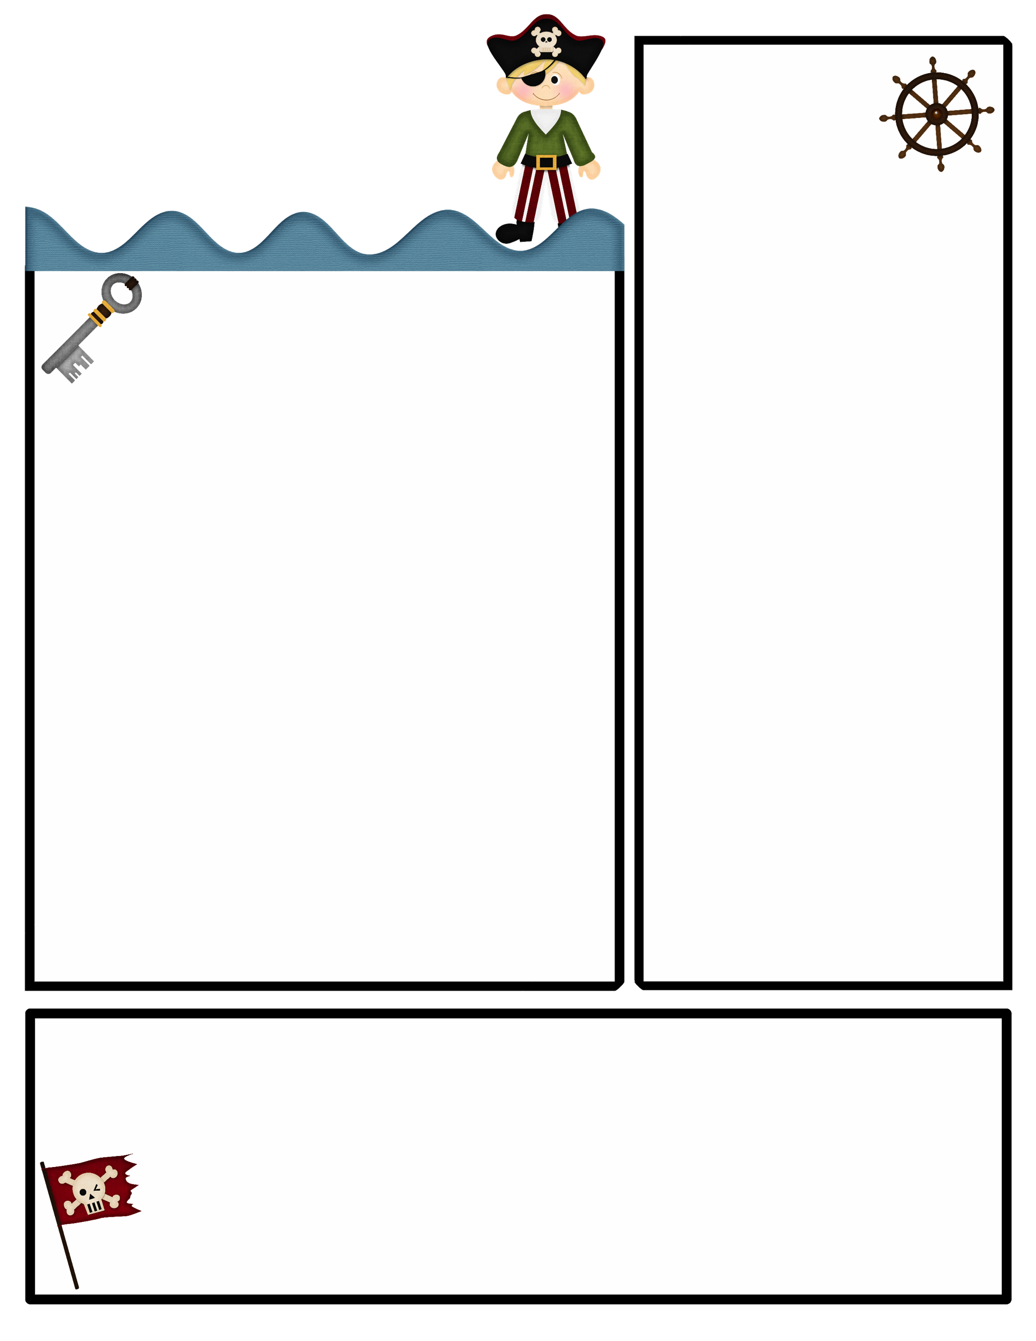
1st Grade News
Upcoming Events
October 23rd – 27th
Please read EVERY night and record on reading log!
Please practice tying shoes (Students should be able to do this independently by Christmas)!!
Don’t forget to sign behavior sheet nightly! ☺
4. Please send a snack DAILY !!!
Fall Festival is Tuesday October 31st. Please turn in all items on or before!
Pumpkin Book Reports are due TODAY!!
What We’re Learning!
Reading:
Story: On the Map
Skill: Main idea , Summarize, and Retell
Vocabulary Words: amazed, frequently, service, useful, variety
Phonics: Short o sound; phoneme blending and segmentation, Capitalization, sight words, and letter formation and sounds review, middle sounds, and irregular plural nouns.
Math:
We are working on finding the missing addend , adding to 20 and starting doubles. Math Vocabulary: Add, equals, count on, addition, sum, part, whole , subtract, difference. Science: We will continue our unit on the Earth, Moon and Sun.
Social Studies: We continuing our unit on communities and learning about their helpers and comparing communities then and now
Spelling List C
See, so, they, can, my
Spelling Test is on Friday 10/27
Selection Test is on Thursday 10/27
Weekly Assessment is on Friday 10/27

